Slide 1
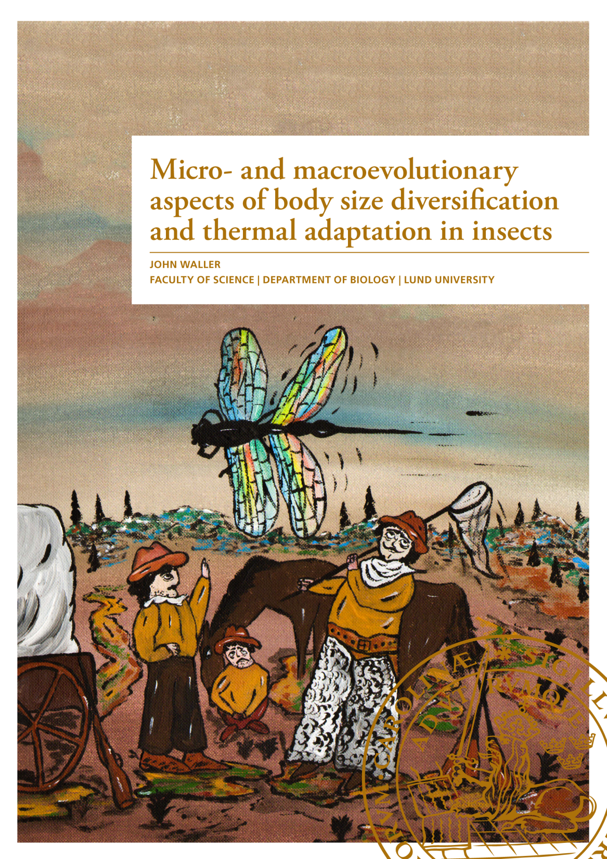
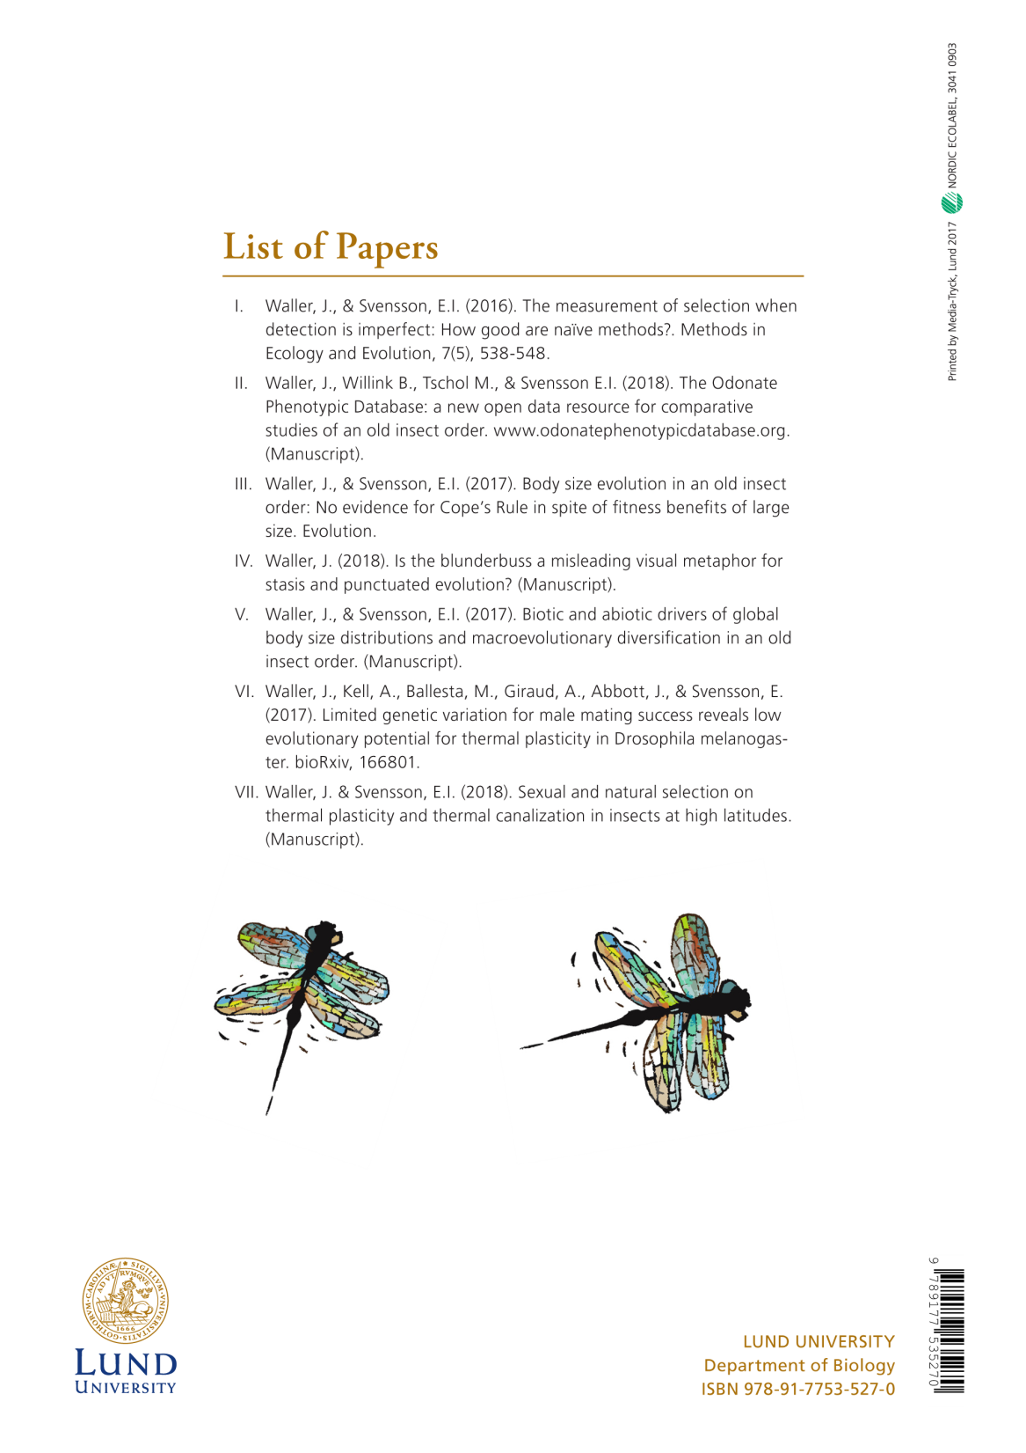


Slide 2


Slide 3
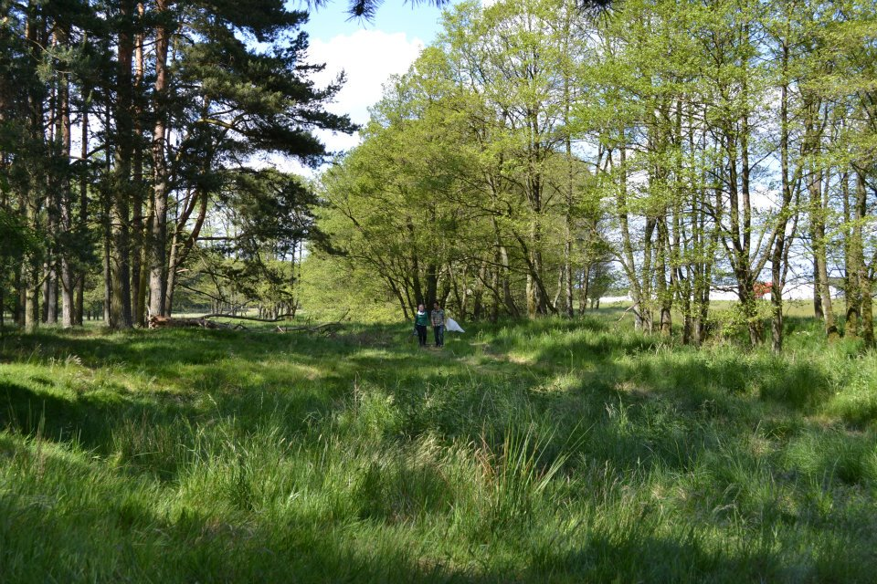

Slide 4
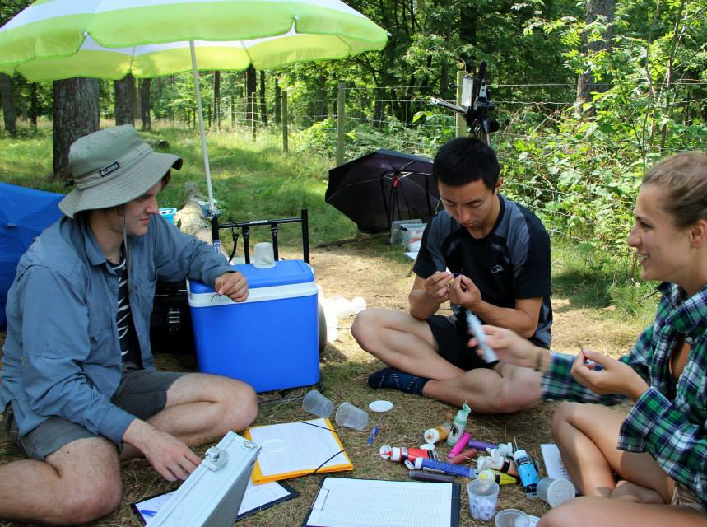

Slide 5
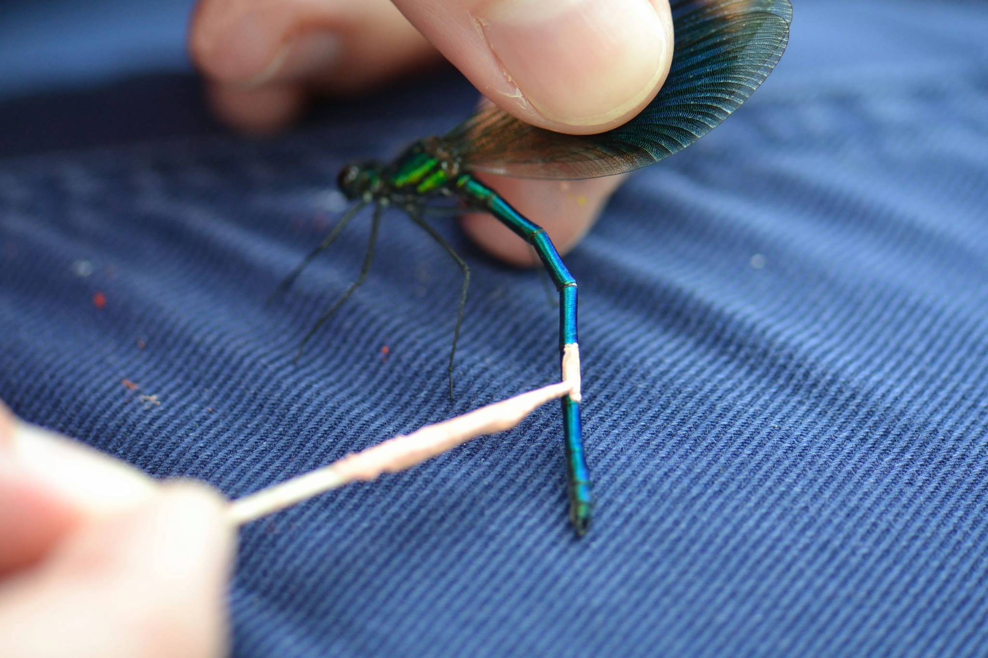

Slide 6
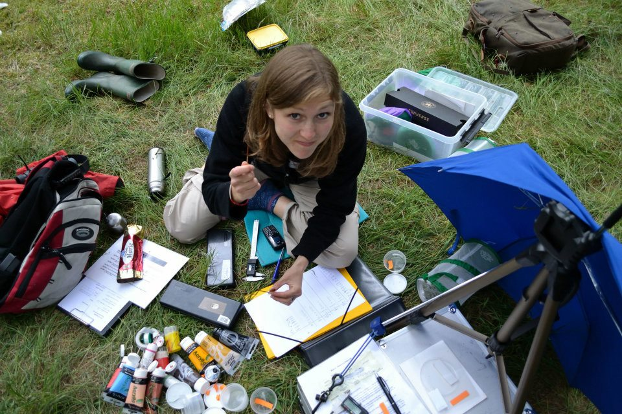

Slide 7
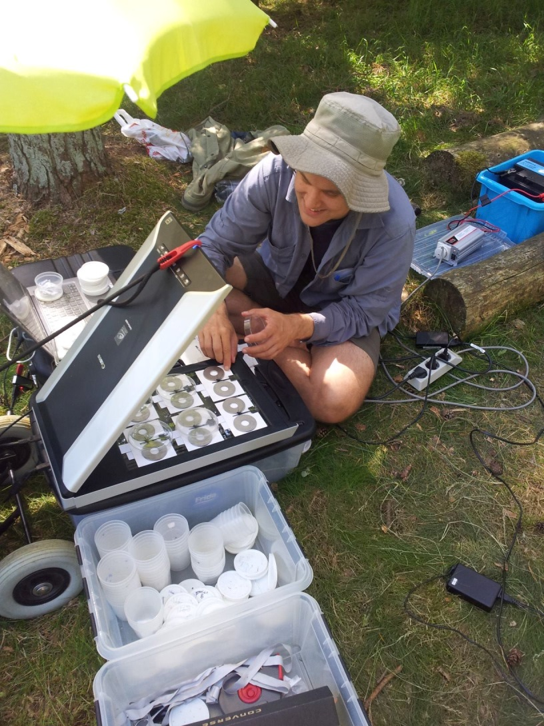
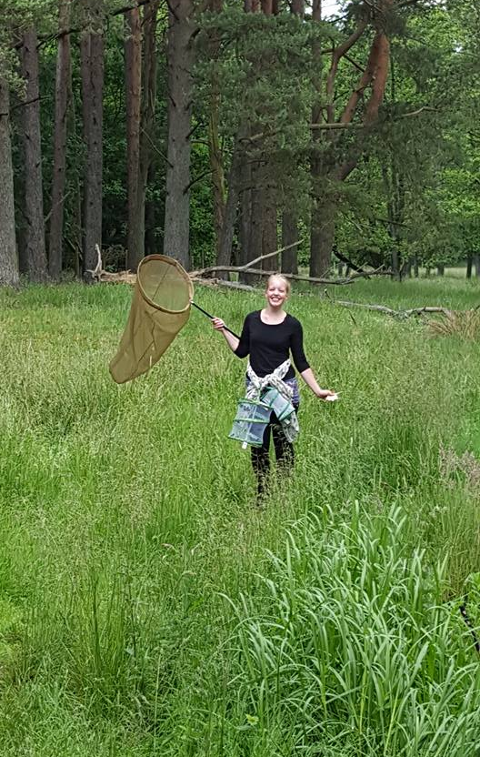

Slide 8
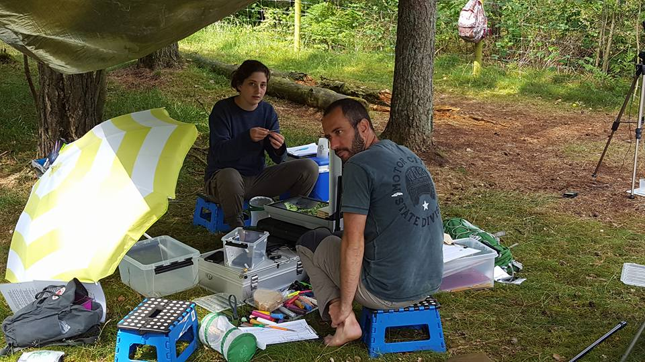

Slide 9
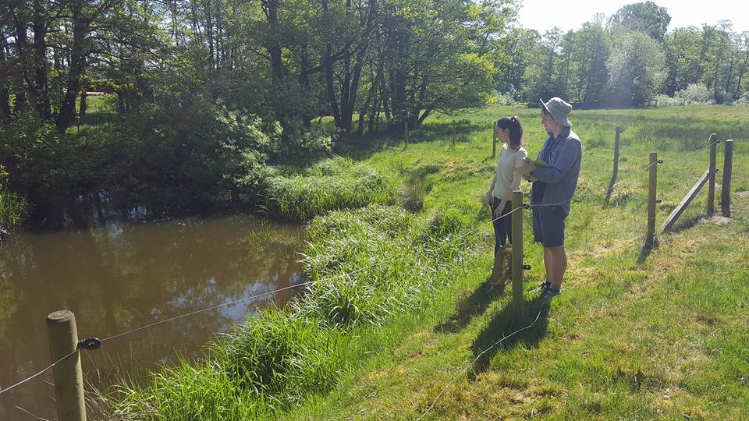

Slide 10
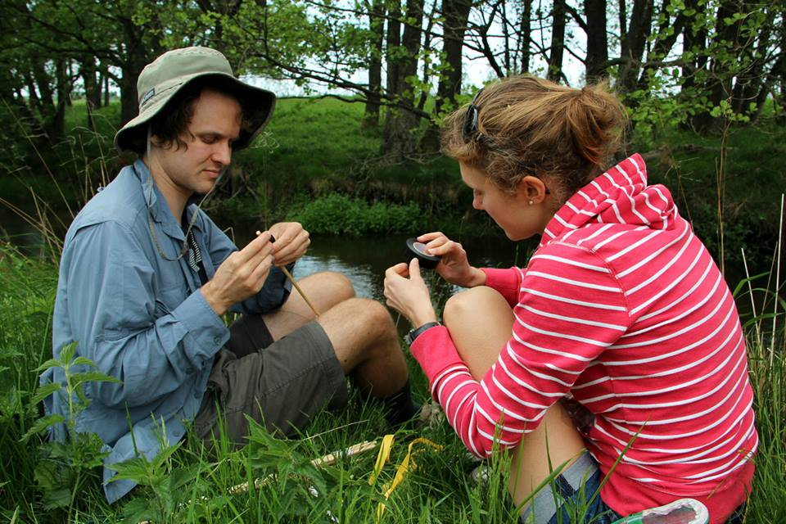

Slide 11
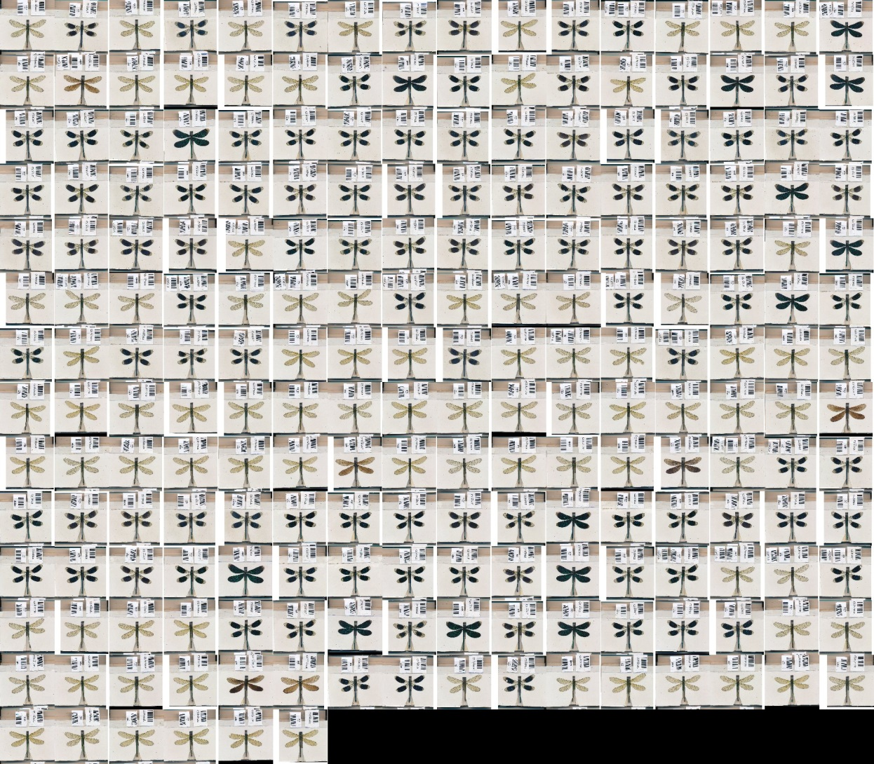

Slide 12
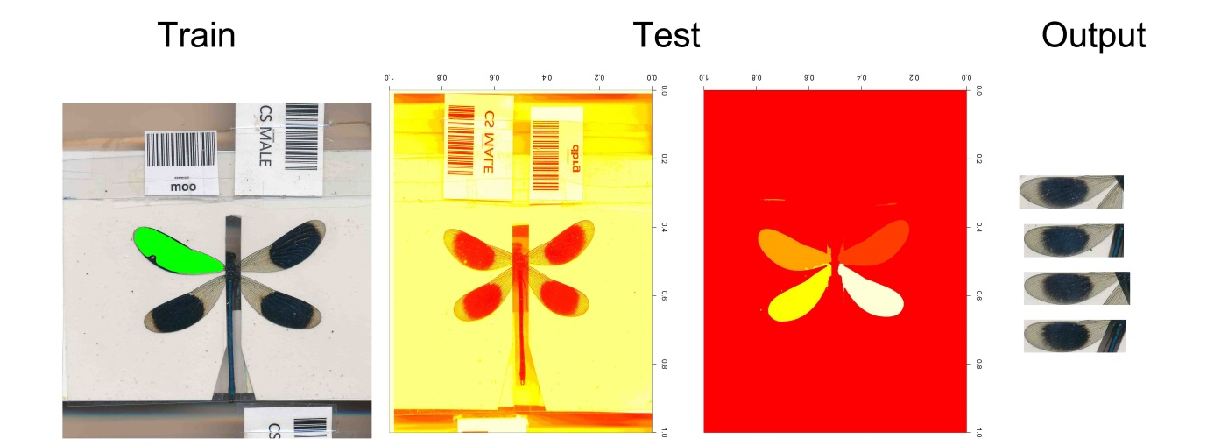
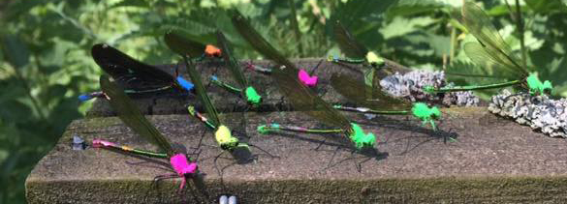

Slide 13
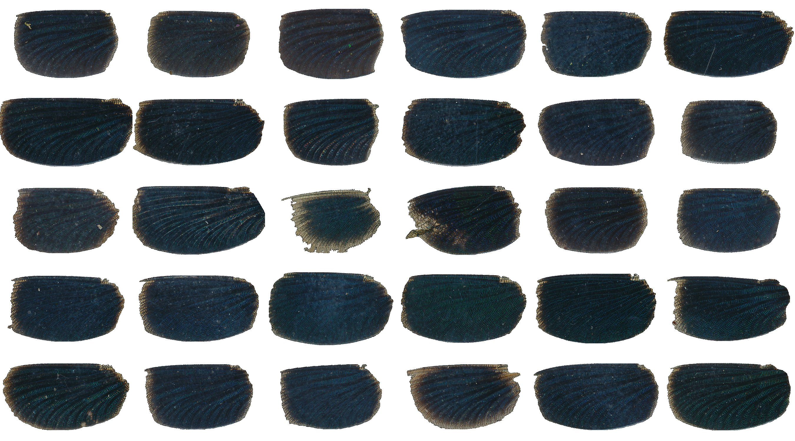

Slide 14
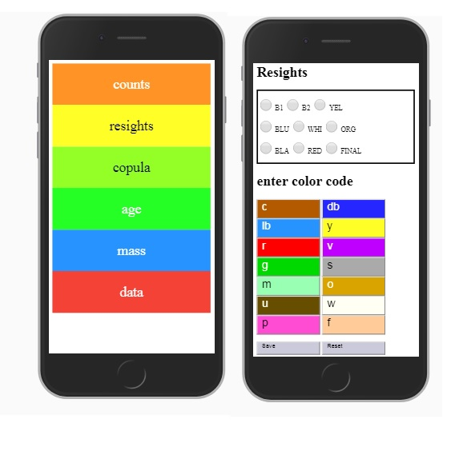
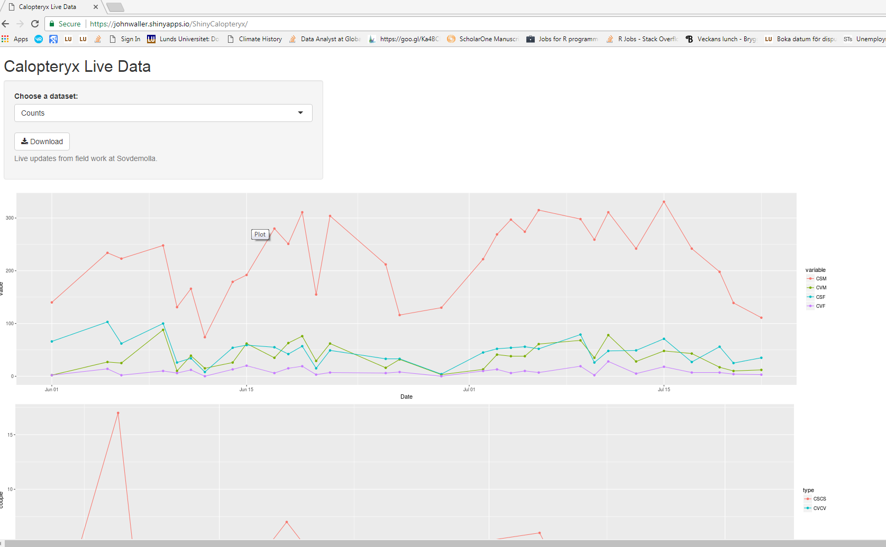

Slide 15
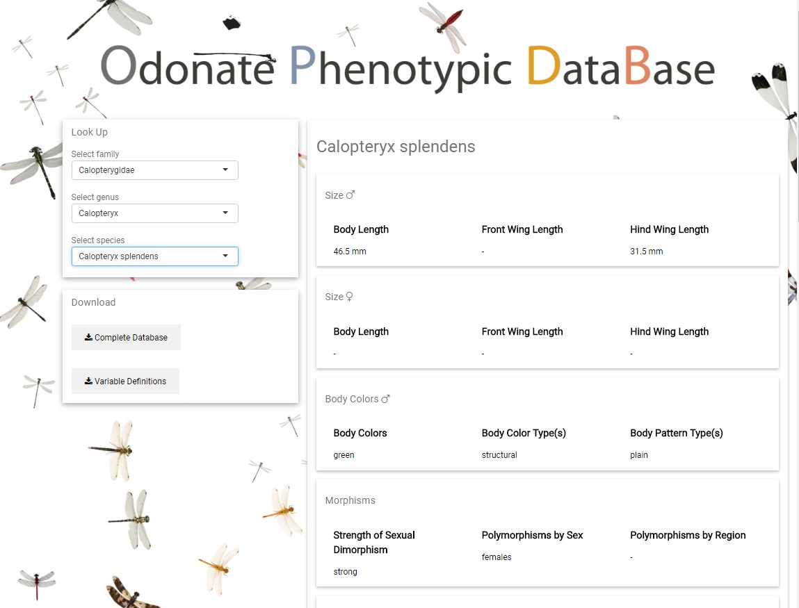

Slide 16
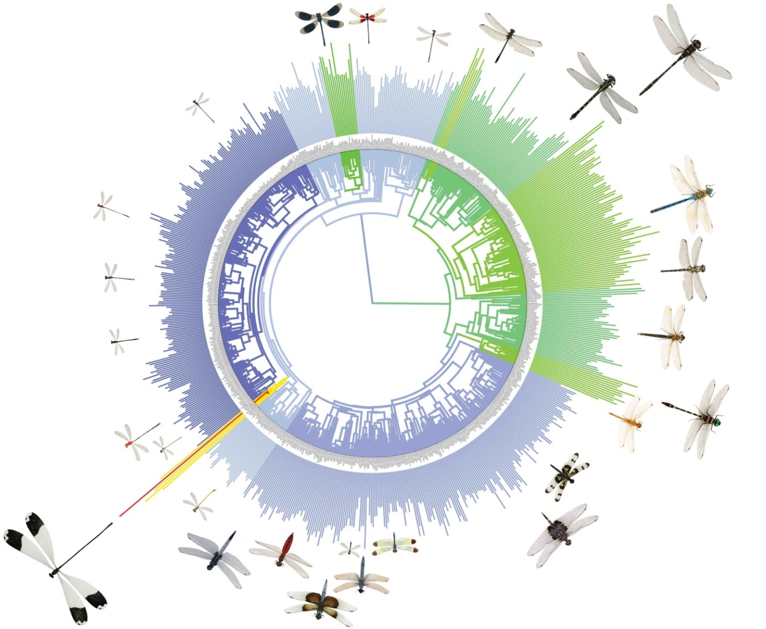

Slide 17
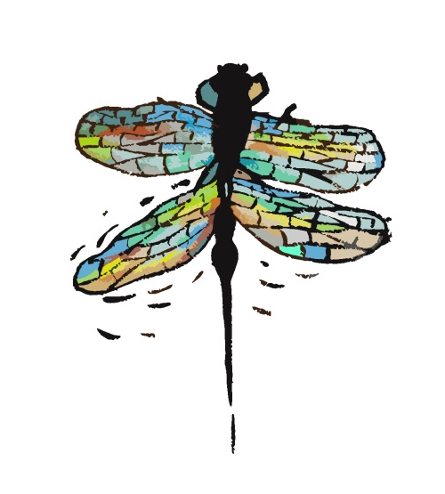

3 rules of insects
1. bigger is better
2. hotter makes you smaller
3. hotter is better
Kingsolver and Huey (2008)

Slide 18
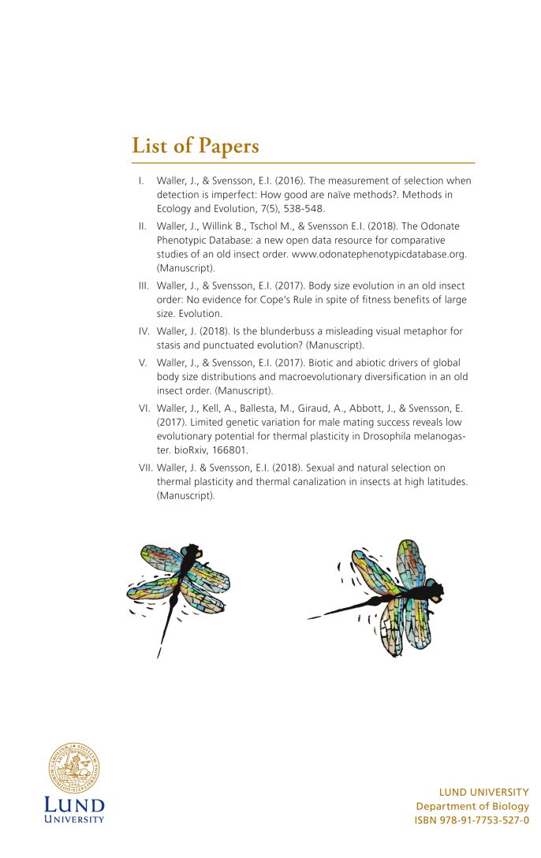
Methods
Rule 1: bigger is better
Rule 2: hotter makes you smaller
Rule 3: hotter is better

Slide 19
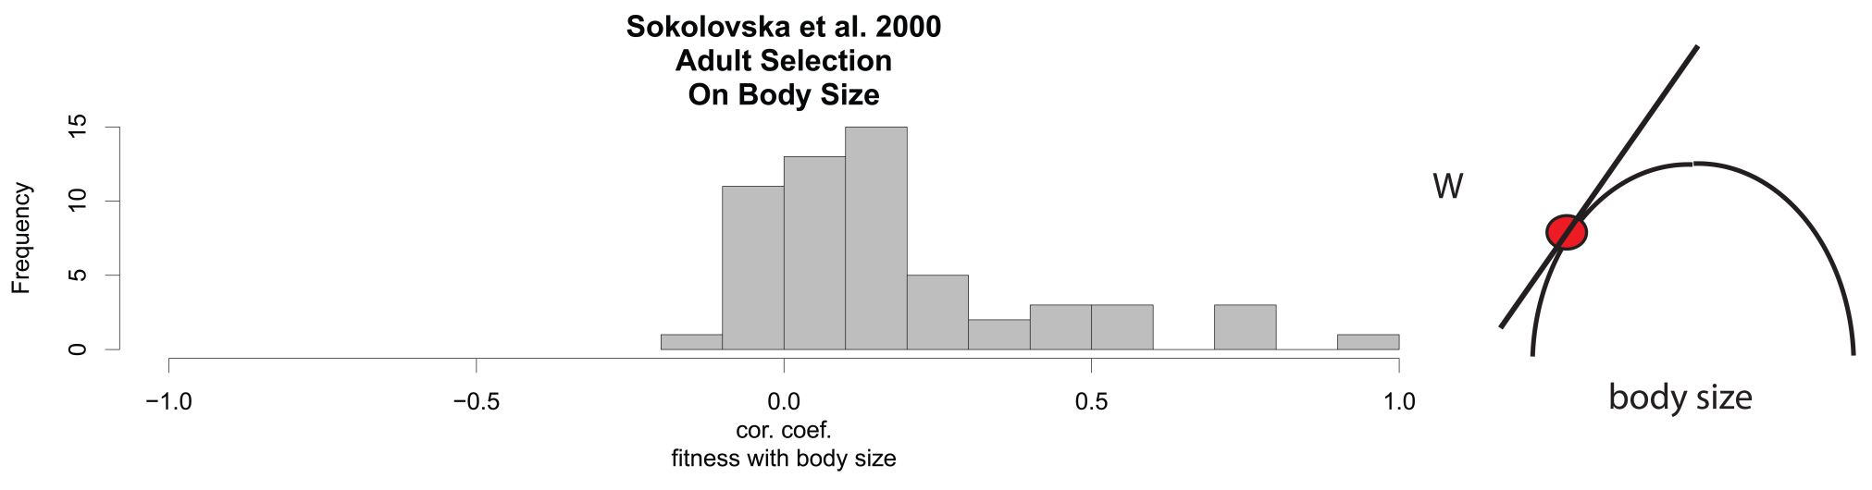
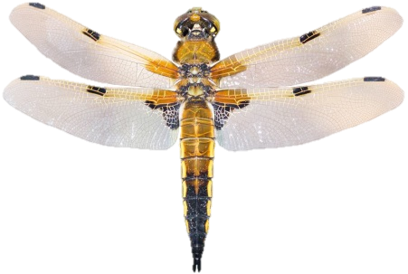


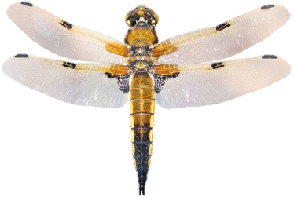

Rule 1: Bigger is Better

Slide 20
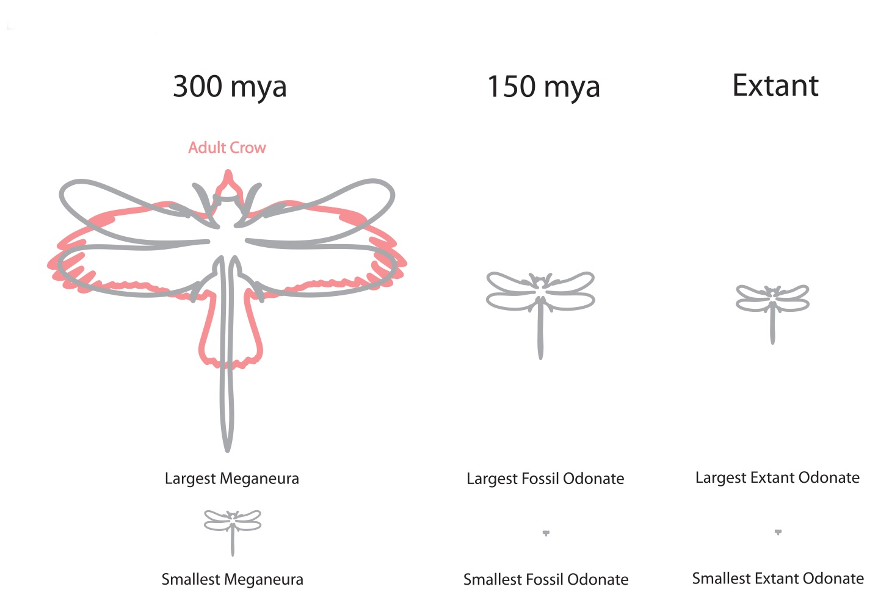

Slide 21
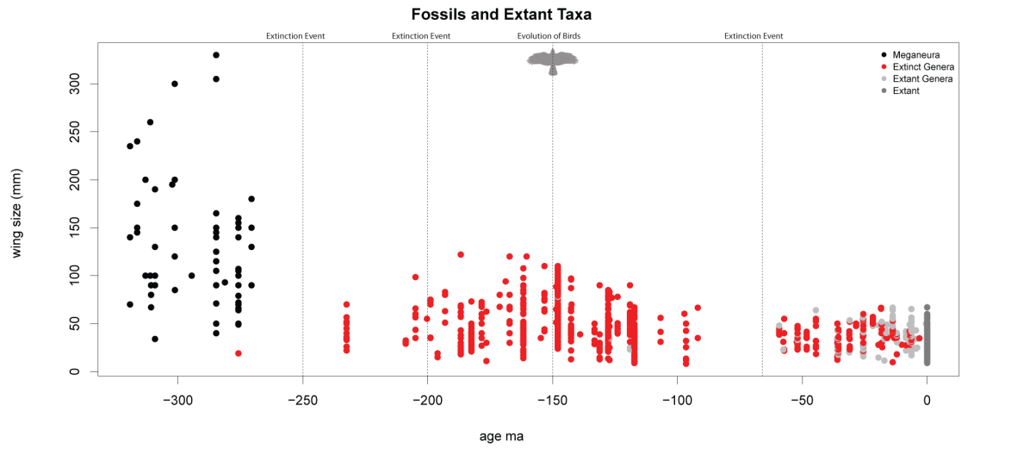
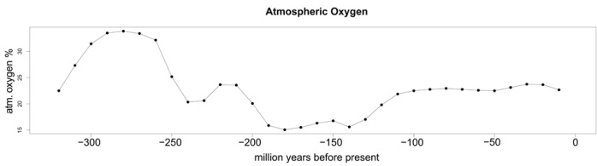

Slide 22
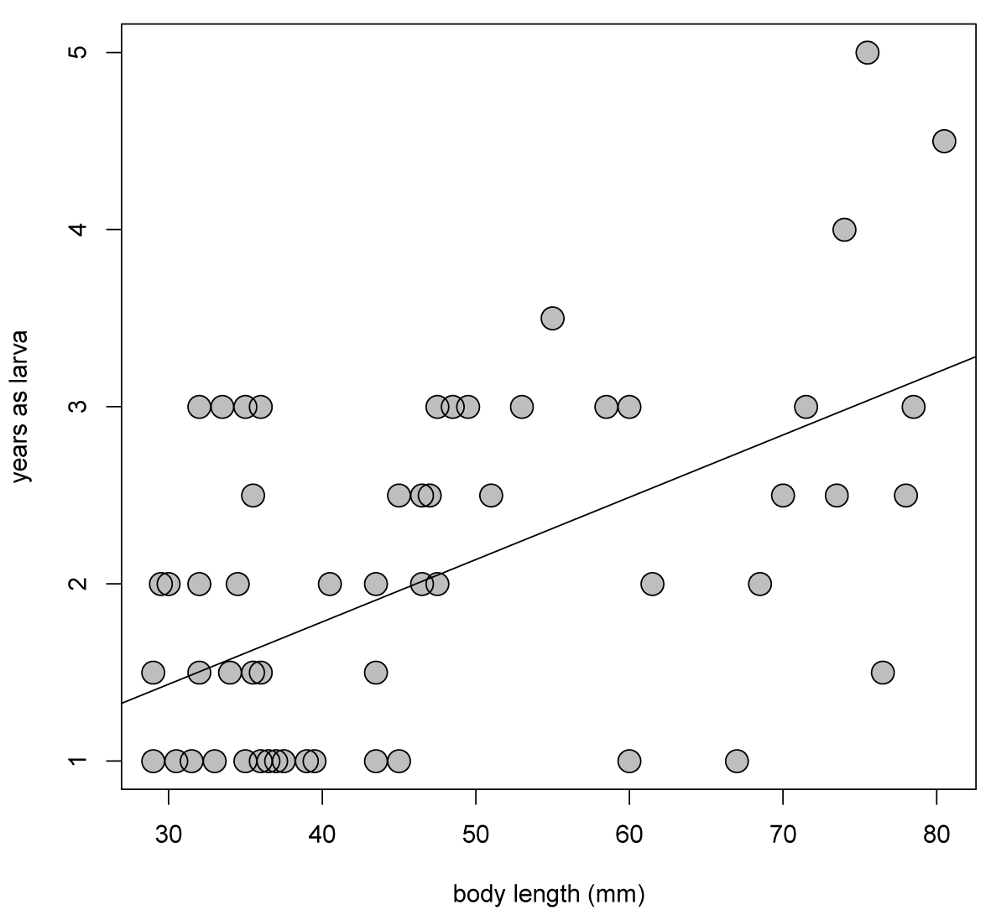

Slide 23
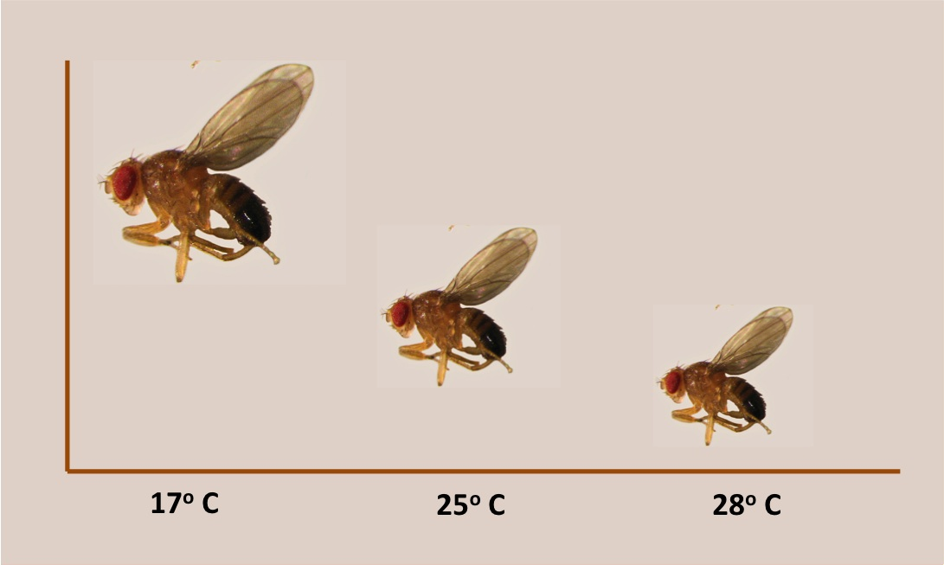
Rule 2: Hotter is Smaller

Slide 24
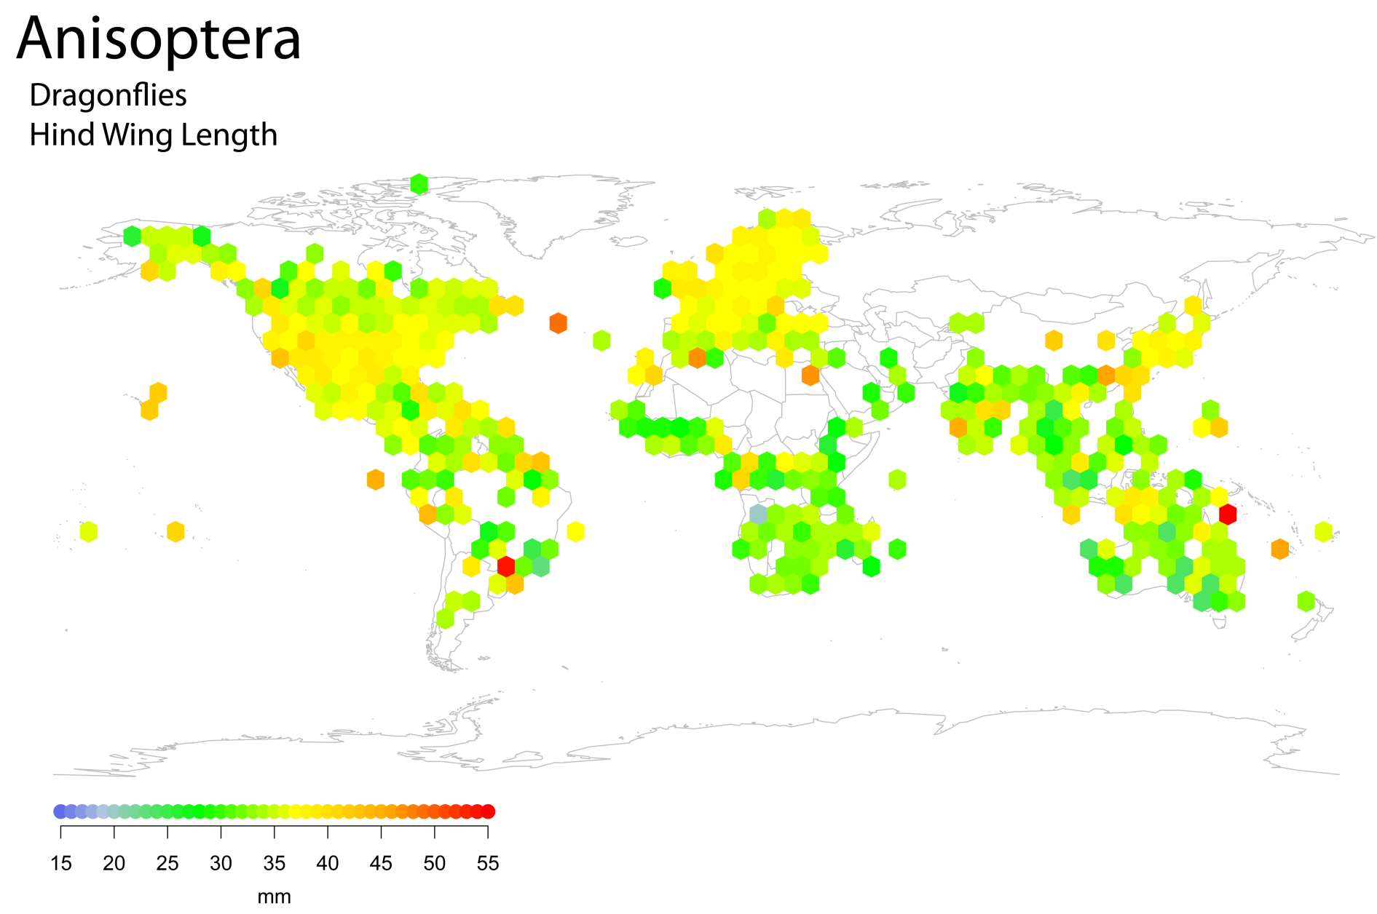

Slide 25
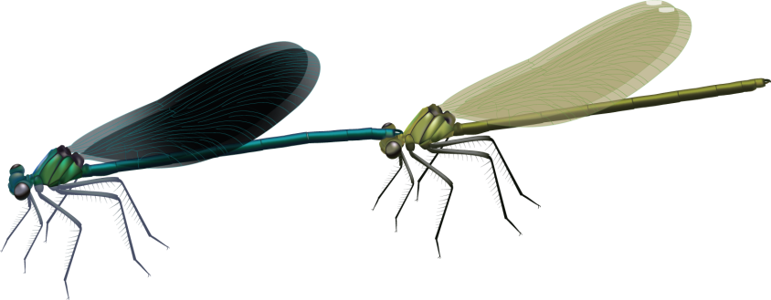
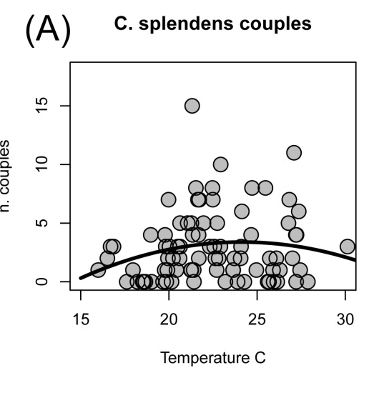
”Rule” 3: Hotter is Better

Slide 26
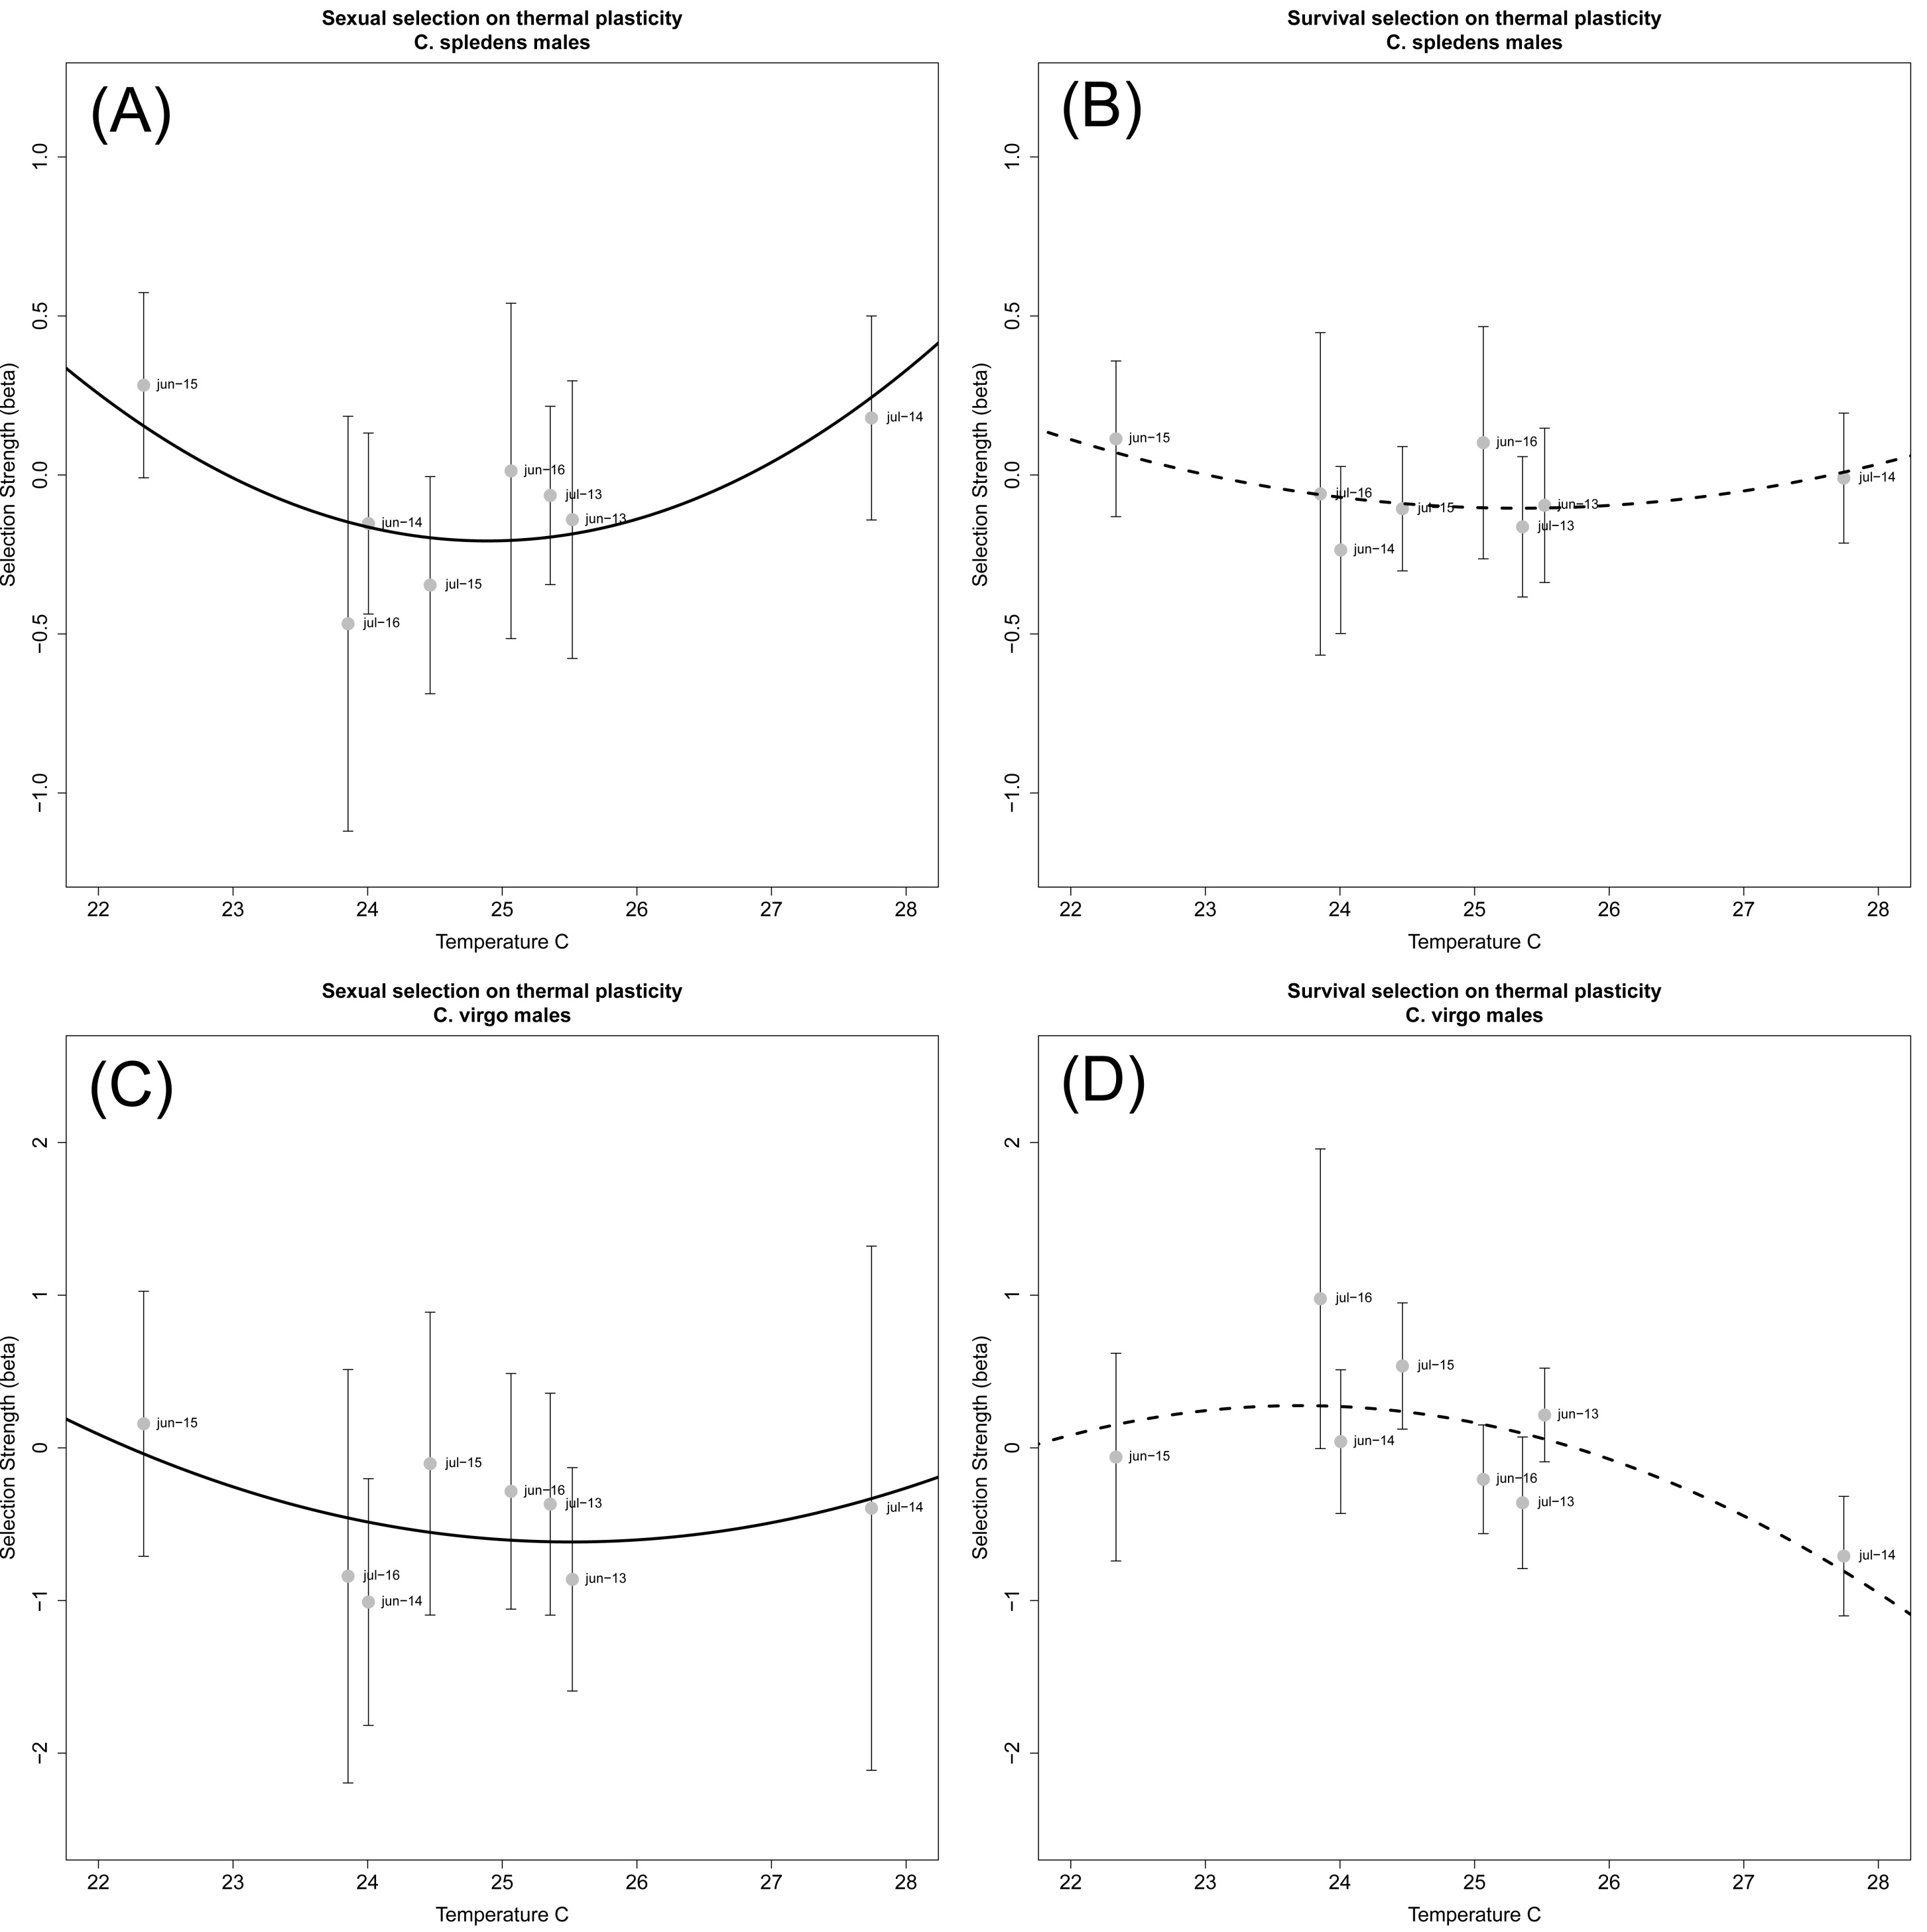
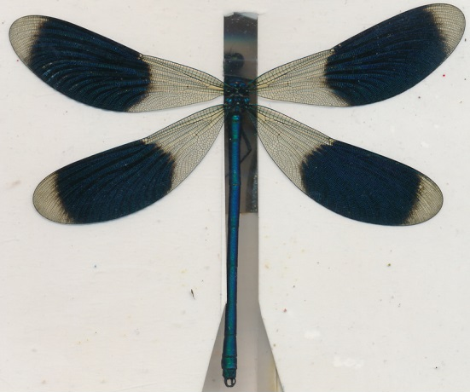
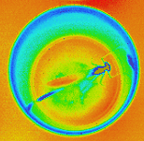

Slide 27
New rules of insects
bigger is better, but time in the larval stage is limited.
hotter makes you smaller, but so maybe also do birds.
3. hotter is not always better, but thermal plasticity is favoured in extreme conditions.

Slide 28
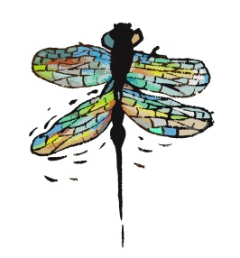
Acknowledgements
Erik Svensson Jessica Abbot Jan-Åke Nilsson Anders Hedenström
Co-Authors
Anna Kell, Mireia Ballestà, Aude Giraud, Max Tschol, Beatriz Willink, Jessica Abbot, Erik Svensson, Anna Runemark, Tom Gosden, and Anna Norden.
Field Work
Sopia Engel, Anna Kell, Mireia Ballestà, Miguel Gomez, Kaili Boarman, Shawn Kutcha, Stephany Herman, Kajsa Svensson, Tammy Ho, Rasmus Johansson, Hanna Bensch, Chiara Despasqual, Johanna Eklund, Emil Fjellstedt, Qinyang Li, Eric Leach, Lisa Winberg, Rebecka Thise, and Karolina Pehrson.
Odonate Phenotypic Database
Kajsa Svensson, Robin Pranter, Lisa Winberg, Ev Poslin, Hanna Bensch, and Karolina Pehrson.

